Slide 1
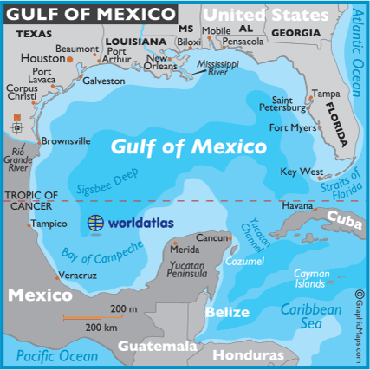
Using Python to Compare Models and Plot Particle Distribution Following the Lagrangian Flow Network in the Gulf of Mexico
By: Jessica Stevens
https://www.worldatlas.com/aatlas/infopage/gulfofmexico.htm

Slide 2
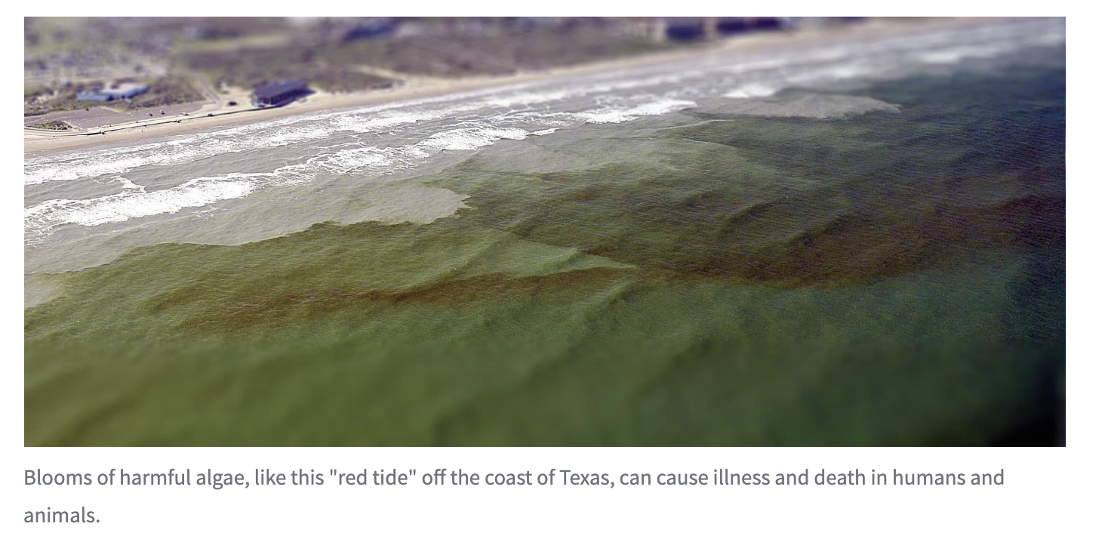
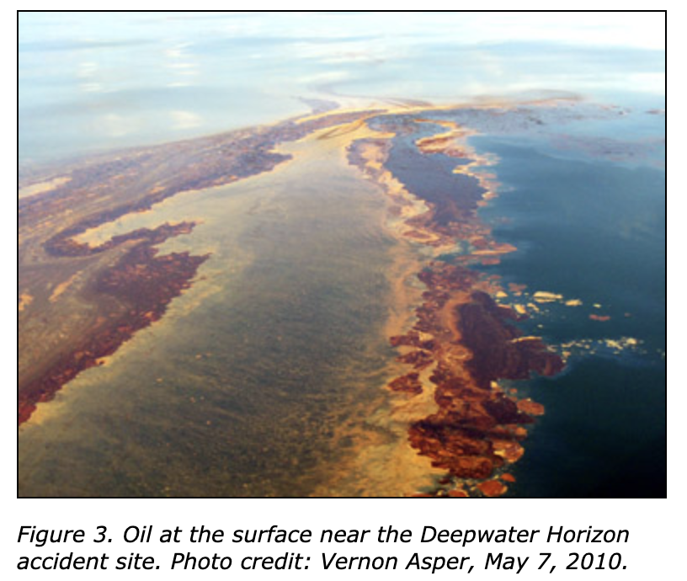
Background
Biological transport
ex. Mesophotic coral connectivity
Retention processes
Ex. Harmful algal blooms, Red Tide
Pollutant transport
Ex. Deepwater Horizon oil spill
(US Department of Commerce & National Oceanic and Atmospheric Administration 2019)
https://gcrl.usm.edu/whaleshark/oil.impact.php.
Notes:
Transport, dispersal and connectivity within and outside of the Gulf of Mexico (GoM) due to the effects of the Loop Current (LC) is a crucial process to understand
The societally and economically relevant processes that make it crucial are
biological transport and connectivity, for example, spawning sites of mesophotic corals relies on distribution through currents. the LC and its eddies need to be known to determine connectivity between sites.
retention processes leading to harmful algal blooms such as the red tide that has been a nuisance to coastal communities around the GoM. When there’s a level of upwelling and an entrapment of nutrients these blooms occur, which are known to kill many fish populations and even make the coastal air toxic to breathe.
and pollutant transport such as what was seen with the Deepwater Horizon oil spill. If an eddie hadn’t been shed, Florida’s MPA would’ve taken a lot of damage. Luckily, the loop current detached and somewhat contained this spill from reaching these ecosystems.
What exactly is the Loop Current?

Slide 3
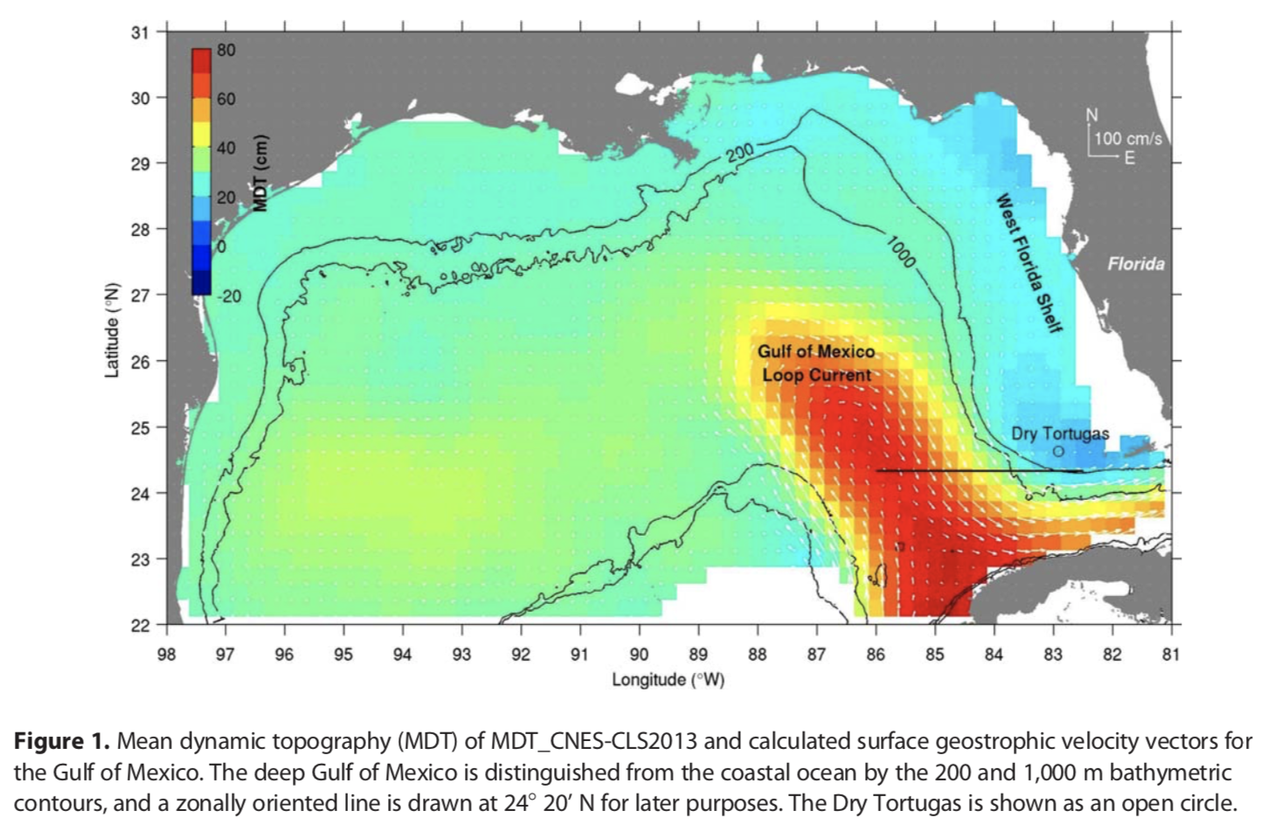
Weisberg et al.
Introduction
Loop Current (LC)
Tropical waters enter the Gulf of Mexico (GoM) through the Yucatan Channel
Exits around Florida and becomes the Gulf Stream
Notes:
The Loop Current is formed from warm, tropical waters that enter the Gulf through the Yucatan Chanel. Which exits around Florida and becomes the Gulf Stream that travels northward up the East Coast.
This figure from Weisberg et al. illustrates the loop current in red. It shows the mean dynamic height field calculated from 25 years of satellite data in the Gulf of Mexico and shows surface velocity vectors (calculated from a dynamic height gradient) lightly in white arrows around the LC. The black lines surrounding the coast are bathymetry lines in the GoM.
(Satellite data from: Archiving, Validation, and Interpretation of Satellite Oceanographic Data (AVISO1) multimission gridded sea level anomaly data set produced by the Ssalto/Duacs with support from the Cnes)

Slide 4
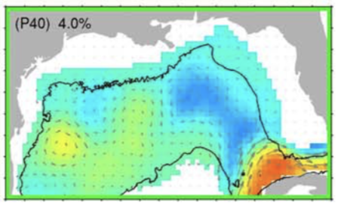
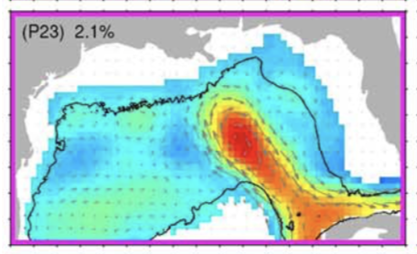
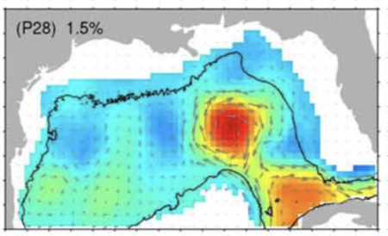
Introduction
LC 3 main states:
Retracted (green)
Extended (magenta)
Detached (no highlight)
Weisberg et al. Fig. 6
Notes:
The LC has 3 main states: 1) retracted (highlighted in green), where the LC barely penetrates the GoM, and the connection between the Yucatan and Florida Currents is short, 2) extended (highlighted in magenta), where the LC extends north, up to the Texas-Louisiana shelf break, bringing Caribbean waters into the GoM, and 3) detached (not highlighted), a transitional state where the LC releases an anti-cyclonic warm-core eddy containing Caribbean waters that then travels westward within the GoM. These eddies can entrap nutrients, phytoplankton, and other small, non-motile organisms (Sebille, et al., 2017).
These figures illustrate characteristic patterns of the Loop Current behaviors in the Gulf of Mexico extracted by a Self-Organizing Map
Sea surface height and surface geostrophic velocity vectors are shown for each pattern, with the pattern number and its frequency of occurrence given in the upper right of each plot
The black line is the 1,000 m isobath
How does one obtain this data?

Slide 5
Introduction
HYCOM – HYbrid Coordinate Ocean Model
Surface elevation (m), temperature (deg C), salinity (psu), water velocity (m/s)
GEKCO - Geostrophic and EKman Current Observatory
Surface height (cm), surface water velocity (cm/s), pressure (Pa)
Notes:
We obtain the data from ocean models such as HYCOM and GEKCO.
HYCOM is a data-assimilative hybrid isopycnal(iso-density informally)-sigma-pressure (generalized) coordinate ocean model (called HYbrid Coordinate Ocean Model).
It uses an assimilation of satellite altimeter sea surface height and sea surface temperature as well as in situ temperature, salinity, and float displacement.
GECKO is Geostrophic and Ekman Current Observatory. Geostrophic velocities (u and v). Ekman regression model of the wind-driven current
"The determination of GEKCO is based on the assumption that the near-surface velocity field can be decomposed into a geostrophic component and a wind-driven part." (Sudre et al. 2013) The Geostrophic flow refers to the steady ocean currents derived from hotizontal pressure gradients and the Coriolis force. The Ekman currents are wind-driven currents resulting from the balance between the frictional stress dud to the wind and the Coriolis force.
(https://aslopubs.onlinelibrary.wiley.com/doi/pdf/10.1215/21573689-2071927)
What does one do with this data?

Slide 6
Introduction
Lagrangian: follows particles as they move over time
Eulerian: tracks particles that flow through one region over time
Lagrangian Flow Networks (LFN):
Self-organizing maps (SOM, machine learning) made from observational data on the GoM LC state will composite our LFN model.
Notes:
Using Network Theory and Lagrangian oceanographic modeling (Lagrangian Flow Networks, LFN) along with self-organizing maps, we will assess ocean climate states.
The Lagrangian Flow Network or LFN is made from observational data on the GoM LC state that's composited into self-organizing maps or SOM which is a type of machine learning.
The ouput is is a .trac file and .matrix file that allows us to plot the final locations of the particles or in the matrix case see where the particles started and ended to determine connectivity in the Loop Current.
What does one do with this output?

Slide 7
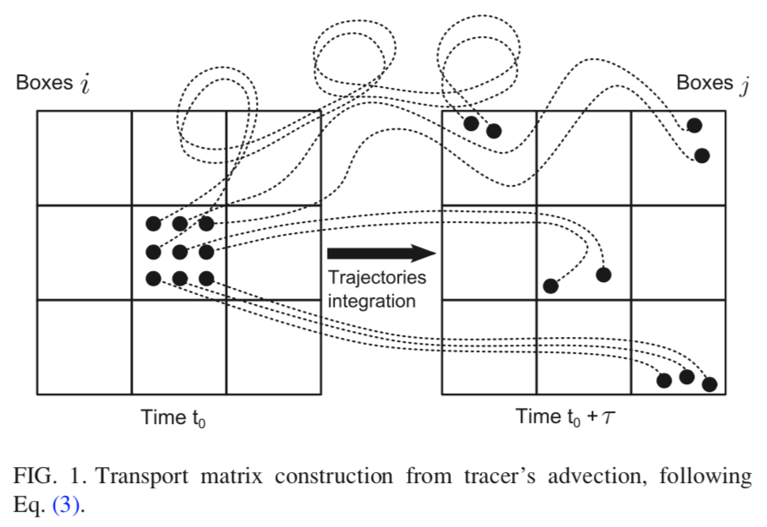
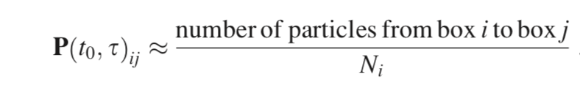
Introduction
Particle Matrices
Boxes i are the starting particle locations at the beginning of the run (time t₀)
Boxes j are the final particle locations at the end of the run (time t₀+ τ )
Ser-Giacomi et al. Fig. 1 & Eq. 3
Notes:
We track the effects of the LC by creating a particle matrix (or grid) over the GoM. Pictured is a simplified version of what our Lagrangian Flow Network code calculates as illustrated in Ser-Giacomi et al.
Boxes i are the starting particle locations at the beginning of the run time t naught.
Boxes j are the final particle locations at the end of the run time t naught plus tau or the length of the run.
While the LFN code follows the patterns of the LC our particles get pushed around from their initial starting box in i. The final recorded destinations shown in boxes j are what we use to create our connectivity matrices.
P is our transport matrix from start to finish time in regards to boxes i and j. We take the number of particles that traveled from box i to box j and and divide it by the initial number of particles N_{i}.
The idea is to plot these final outcomes to see the connectivity between regions

Slide 8
Research Questions
Do the HYCOM and GEKCO models output of sea surface height and velocity patterns correspond?
Do the HYCOM and GEKCO outputs resemble Weisberg et al. Figures?
Reasoning:
LFN particle distribution relies on the HYCOM model for predictions
Defending the reliability of HYCOM is seminal
Notes:
My research questions are
Does the HYCOM and GECKO model output of sea surface height and velocity patterns correspond?
Do the HYCOM and GECKO outputs resemble Watson et al. figures?

Slide 9
Methods: Plotting HYCOM and GEKCO
Using one month.
>>file = ‘/Users/xfm684/Documents/Research/HYCOM/hycom_gomu_501_2002*0100_t000.nc’
GoM reanalysis from HYCOM imported to xarray
>>test = xr.open_mfdataset(file, decode_times = False)
Plot sea surface elevation
>>plt.subplot(2,2,1)
>>m.pcolormesh(test.lon, test.lat, test.surf_el[0,:,:])
Use quiver plot to show velocity vectors
>>q = plt.quiver(test.lon, test.lat, test.u[0,0,:,:], test.v[0,0,:,:])
Repeat for GEKCO data
>>plt.subplot(2,2,2)
Notes:
To plot one month of data when we upload the files we use a glob or asterisk over the section in the file name that refers to the month. In this example we are the plotting the first of every month in the year 2002.
To import the netCDF files into xarray we use open multiple files dataset since we are uploading 12 files instead of just one.
To plot HYCOM and GECKO side by side we need to use subplotting. I plotted HYCOM first so the final value in this subplot call is a one. Using pcolormesh I plotted the data over the longitude and latitude, using the variable surface elevation. The zero is for first variable time, the colons represent over all latitudes and longitudes.
To plot the velocity vectors I used quiver plot. You’ll notice u and v has 4 variables instead of 3 like surface elevation. The first is time, the second is depth, in this case I just want the surface so I use the indice 0, and then over all latitudes and longitudes in the dataset.
The same is don’t for GECKO data but under subplot 2.

Slide 10
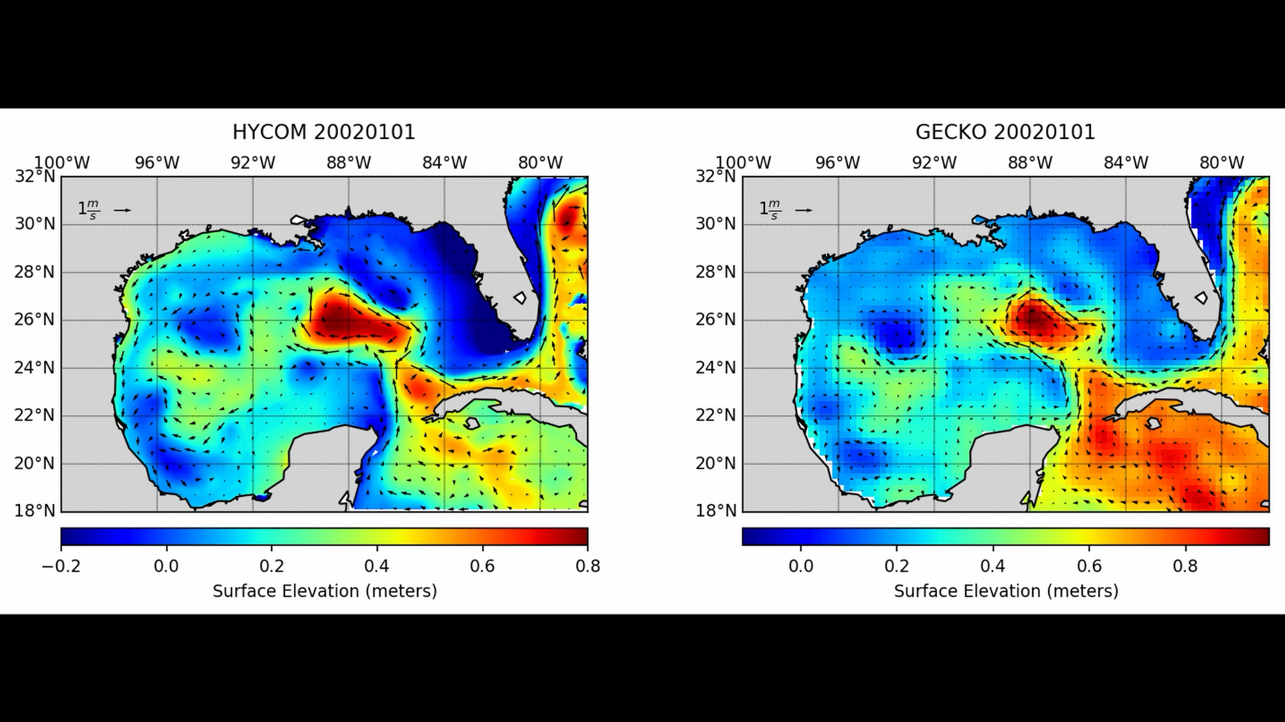
Results
HYCOM and GEKCO model output patterns correspond
GEKCO
Notes:
In this still we’re observing the plot from the first of January 2002 for HYCOM and GECKO model output. Sea Surface Elevation is shown in meters, red being elevated, dark blue being below 0 meters. the velocity is shown by the arrows and has a key in the upper left hand corner for 1 m/s or 100 cm/s. I adjusted the colorbar on the HYCOM data to more closely resemble the color scheme of the GECKO data since they use different methods to normalize their data and I just want to check for correct patterns between the models.
Here we can see that the models resemble each other closely. The overall movement in the gulf due to the LC remains comparable between these models.

Slide 11
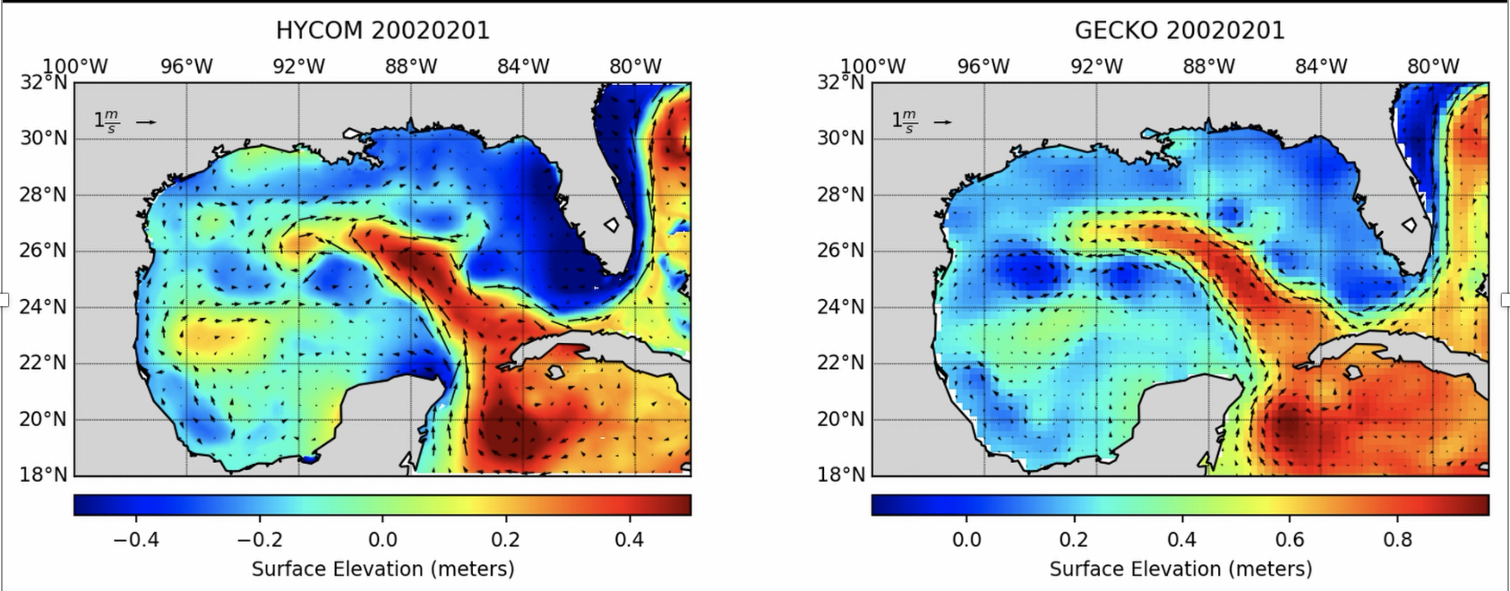
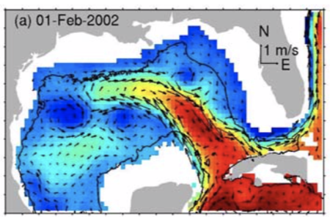
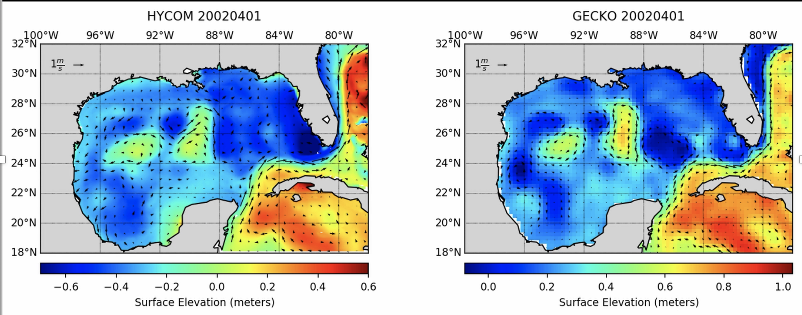
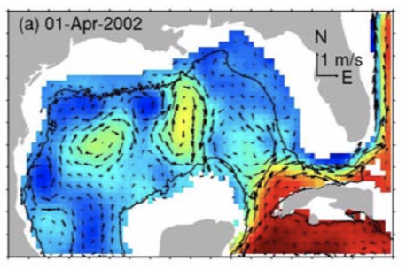
HYCOM GEKCO Weisberg et al.
2002-01-01
Weisberg et al. Fig. 3
2002-04-01
Weisberg et al. Fig. 4
Notes:
Pictured are some plots of February 1st , an extended state, and April 1st , a retracted state, to compare to the Weisberg et al. figures. HYCOM doesn’t have data past 2012 currently so I couldn’t compare the monthly snapshots used in Weisberg et al.
We are able to see similar loop current behavior and elevations. The velocity vectors seem to agree. Eddy placements are also very similar.

Slide 12
Discussion
HYCOM and GEKCO model output agree.
HYCOM and GEKCO output agrees with the Weisberg et al. Figures.
Relevance: LFN code runs on HYCOM data which has proved its reliability.
~Back up your data constantly~
Notes:
My research questions were
Does the HYCOM and GECKO model output of sea surface height and velocity patterns correspond?
The data suggests that they do agree which gives confidence between the two different models
Do the HYCOM and GECKO outputs resemble Watson et al. Figures?
-Yes, the data supports the agreement between all models used to determine sea surface height and surface velocities.
The importance of this verification of data sets is that the LFN code that needs to run for particle distribution in the GoM relies on HYCOM data. The fact that HYCOM is similar to the other model outputs is of significance for reliability of our particle distribution tests.

Slide 13
Questions?

